Slide 1
Prep 4 Assessment
四年级 评估

Slide 2
Aims
评估目标
To share best practice in assessment
To explain formal BMH Reports
To outline Government assessments in our context
To introduce CAT4 - Cognitive Ability Testing
分享评估的最佳实践方式
解释BMH正式成绩报告单
根据学校实际情况，解读教育局的统考
介绍四年级认知能力测试

Slide 3
What is Assessment?
什么是评估？

Slide 4
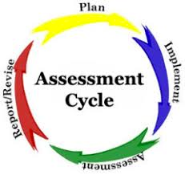
Good Practice
优秀的教学实践
Assessment as ongoing
‘Formative’ v ‘Summative’
Assessment by teachers
Assessment by students
Assessment informing planning
评估在教学中持续进行
形成性评估 VS 总结性评估
由老师评估
由学生评估
根据评估调整学习计划

Slide 5
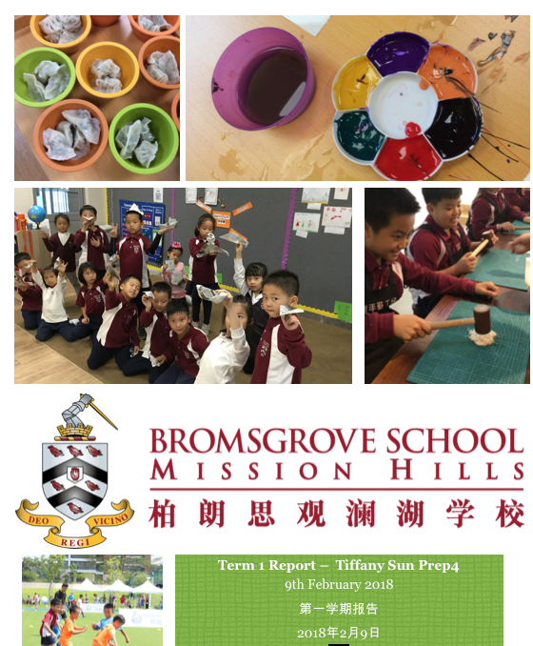
Term 1 Reports
第一学期 评估报告

Slide 6
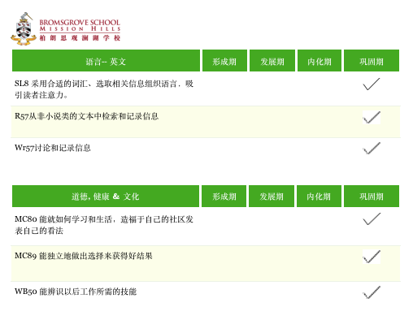
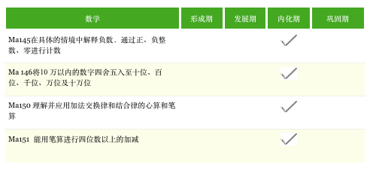

Slide 7
Government Assessments
区教育局统考
Good experience for students
Not testing what we are learning
Different style from local schools
Data helps us refine our practice
English was our strength
Focuses will be Maths and Chinese in Term 2 in response to the data
对学生而言是一次不错的体验
测试内容非我校已教授的内容
我校测评方式与公办学校测试方式不同
测试结果帮助我校完善教学实践
英语为我校优势
基于考试结果，第二学期将重点关注数学和汉语教学

Slide 8
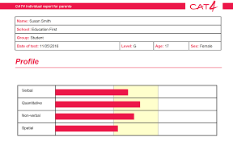
Verbal
Quantitative
Non-verbal
Spatial
四年级认知能力测试内容
词汇认知能力
数字认知能力
非词汇认知能力
空间想象能力

Slide 9
Parents will receive assessment information including:
BMH Formal Term 1 Report
A-C grades for Government Assessments English, Maths, Chinese, Science
CAT4 outcomes
On Friday 9th February
家长将于2月9日（周五）收到评估报告，包含以下内容：
BMH第一学期正式报告
英语、数学、语文、科学等科目成绩按照教育局A-C等级体现
四年级认知能力测试成绩

